Slide 1


Hall Green Primary School
Year 3
YOUR CHANCE TO SHINE

Slide 2
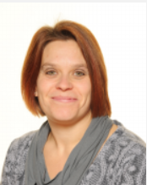
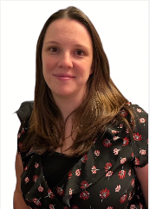
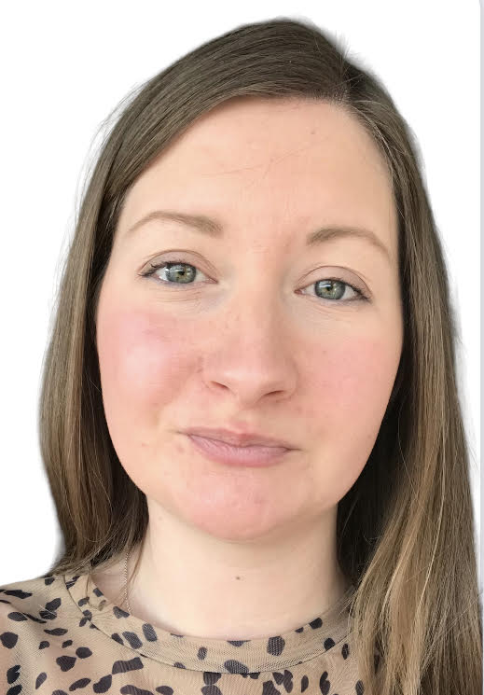
Our Head Teacher, Deputy Head Teacher, Safeguarding & Attendance Officer
Mrs Gilbert Mrs MacDiarmid Mrs Taylor

Slide 3
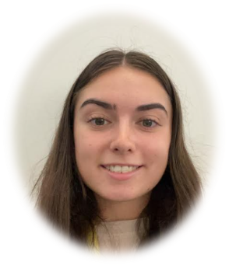
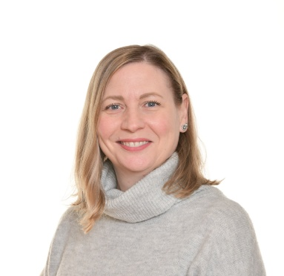

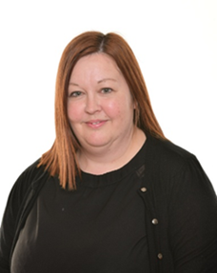

Staff
Miss Gardner Mrs Goodreds Miss Spriggs
Miss Corbett
Mrs Plose-Joyce

Slide 4

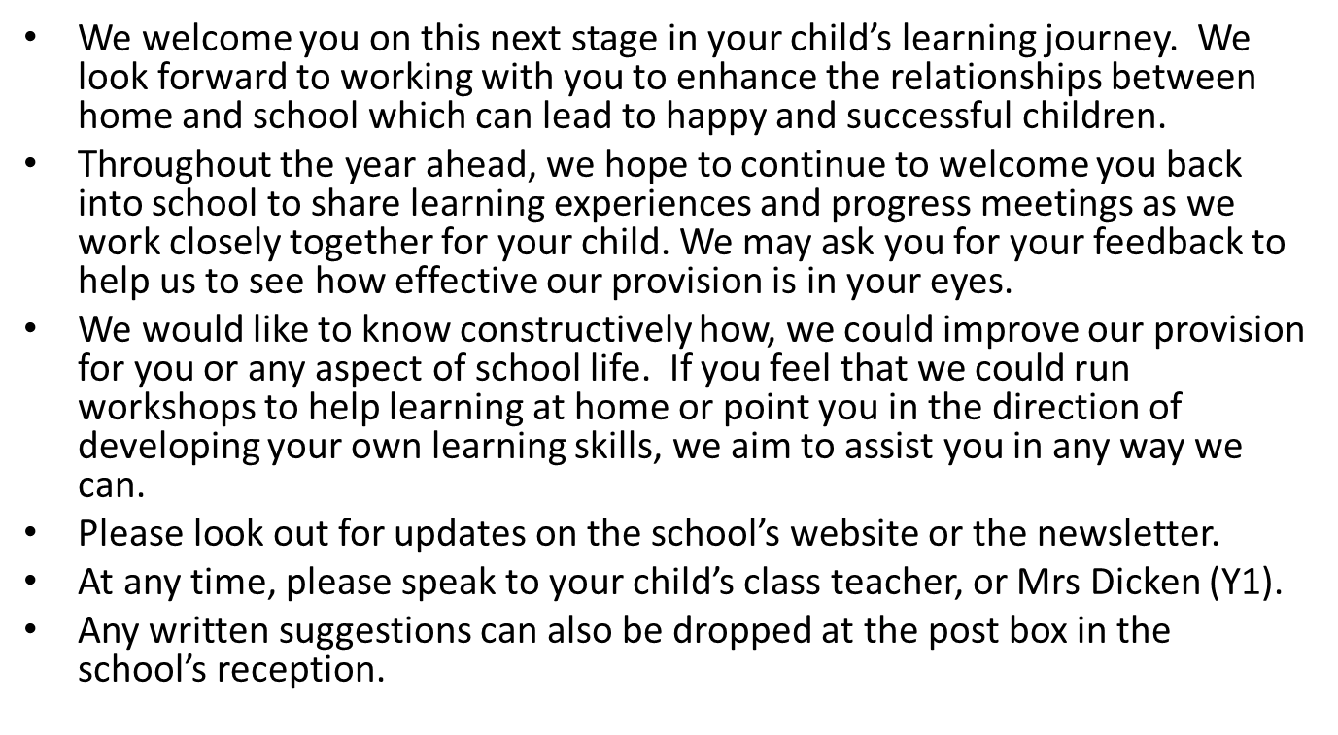
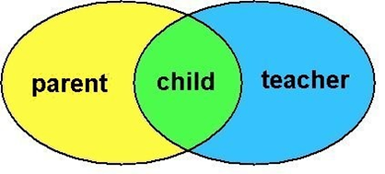

Slide 5


Safeguarding

Slide 6
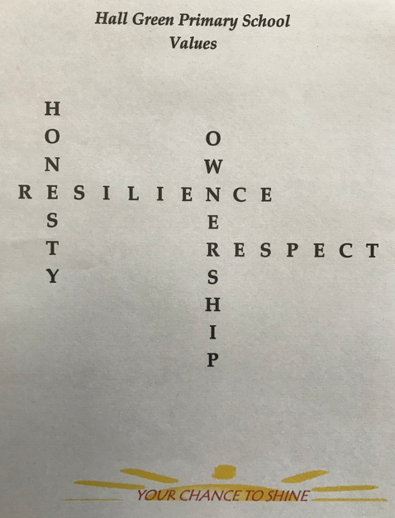


Our School Aims & Values
The aims of the school are the same for all pupils. Within a caring, positive, disciplined and safe environment and in partnership with parents and governors.
Resilience
Perseverance
Courage
Honesty
Trustworthiness
Integrity
Respect
Tolerance
Kindness
Empathy
Co-operation
Collaboration
Ownership
Responsibility
Independence
Accountability

Slide 7
Structure
PM
Science
History /Geography
Computing
RE
Maths Mastery
PE
Art / Music
MFL
Shared reading/ Phonics/ Spelling
Assembly
AM
Registration
PSHE
Shared reading/ Phonics/ Spelling
English
Playtime
Maths
Lunchtime
PE and art or music is on a Thursday afternoon with Mr Turton and Miss Elcock

Slide 8
National Curriculum
Reading
By the beginning of year 3, pupils should be able to read books written at an age appropriate interest level. They should be able to read them accurately and at a speed that is sufficient for them to focus on understanding what they read rather than on decoding
individual words. They should be able to decode most new words outside their spoken vocabulary, making a good approximation to the word’s pronunciation.

Slide 9
National Curriculum
Writing
Pupils should be able to write down their ideas with a reasonable degree of accuracy and with good sentence punctuation. Pupils’ spelling of common words should be correct, including common exception words and other words that they have learnt. Pupils should spell words as accurately as possible using their phonic knowledge and other knowledge of spelling, such as morphology and etymology.

Slide 10
National Curriculum
Maths
The principal focus of mathematics teaching in lower key stage 2 is to ensure that pupils become increasingly fluent with whole numbers and the four operations, including number facts and the concept of place value. This should ensure that pupils develop efficient written and mental methods and perform calculations accurately with increasingly large whole numbers.

Slide 11
Assessments
Termly tests in reading and comprehension ages
Termly maths assessment
Termly assessment of CEW
Writing assessments (2 or 3 a half term)
Daily formative assessment (Insight)

Slide 12
Topics
Summer
Animals including Humans- The Human life cycle (Science)
Local Area - (History)
Greece vs UK. – (Geography)
Healthy meals
Autumn
Stone Age – (History)
Forces – (Science)
Structures (DT) – Scrapyard Grabbers
Drawing – Stone Age (Art)
RnB - (Music)
Tag Rugby & Tennis (PE)
Spring
Outdoor learning
Human Body - (Science)
Volcanoes – (Geography)
Drawing – (Art)
Food Technology (DT) Healthy Pizzas
Dance / Gymnastics and Health and Fitness (PE)

Slide 13
Independence
Remembering to go to the toilet before and after lessons
Remembering their belongings, e.g. bottles, bags, snack, clothes.
Changing their reading book or bringing in their signed reading records
Wear PE kit on a Thursday

Slide 14
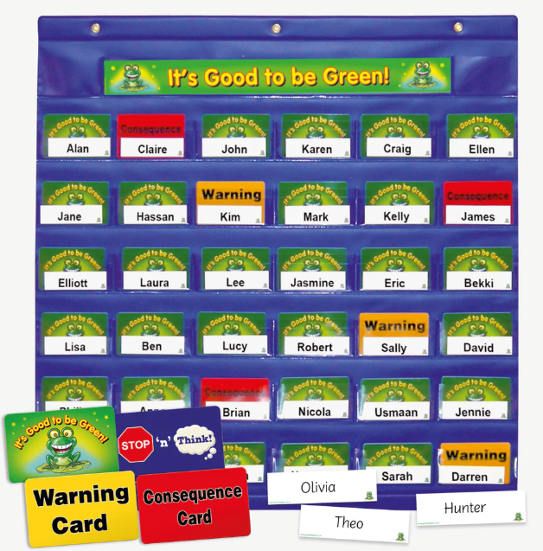
Good to be Green:
• A ‘traffic light’ system is used to give a consistent approach – Good to be Green
• All children begin the day on a ‘green’ light
• If a child chooses behaviour that is inappropriate an initial warning is given
• If behaviour continues, the child is moved to ‘amber’ and they take a yellow warning card
• If behaviour still continues, child is moved to ‘red’ and is sent from the classroom to a specified class – child sent out for 15 minutes
• After 15minutes the child will return to class then go back to having a ‘green’ light.

Slide 15
•If two red lights are received in one day, the child will be sent to the phase lead/AHT and a playtime is missed.
•If more than three red lights in one week, the child will be sent to DHT/HT and a further 2 playtimes are missed. Parents will be notified.
•Consistently poor behaviour, or an extreme incident will go to HT.
•On all occasions, children sent out of class will be sent with work from their teacher.
•The same system will be used at lunchtimes, with a child standing by the wall on a ‘red’ for 5 minutes.

Slide 16
•If a child moves to silver, a reward can be given by the teacher – extra stickers, house points. If a child moves to gold, a reward can be given by DHT or HT.
Rewards:
When and as often as appropriate, positive behaviour will be rewarded with one or more of the following:
•Praise by adults •Peer group praise •House points •Stickers •Prize from Head Teacher for a full sticker chart •Head Teacher or Deputy Head Teacher sticker •Phone calls home to parents •Pupil of the week postcard and button badge •Pupil of the half term (certificate, badge and voucher) •Pupil of the year – category specifically for Attitude and Behaviour

Slide 17
Support at home
Communicate - home time
- Arbor
                - email year3@hallgreenprimary.co.uk
                - newsletters
                - termly calendar
                - website
                - Parents evenings/phone-calls
All About Me meetings/phone-calls
Please make sure your mobile number is up to date with Arbor / office

Slide 18

Thank you for joining us today.
If you have any further questions after today, please email us on:
year3@hallgreenprimary.co.uk

