Slide 1


YOUR CHANCE TO SHINE
Y1 Transition Meeting 10. 07. 25
Welcome to
Hall Green Primary School

Slide 2

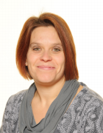
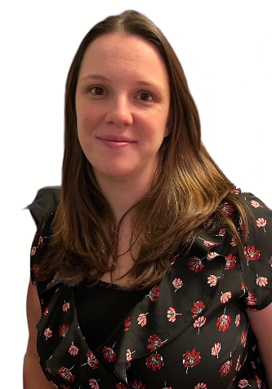
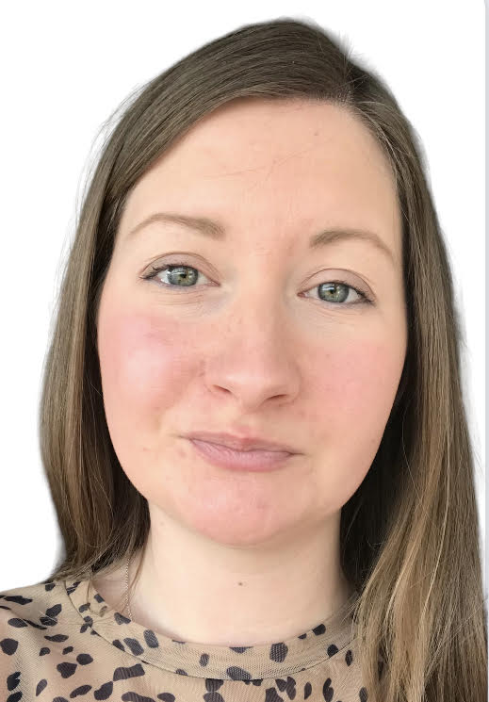
School Leadership
Mrs Gilbert
Head Teacher &
Safeguarding Lead
Mrs MacDiarmid
Deputy Head &
Deputy Safeguarding
Lead
Miss Shipley
Deputy Safeguarding Lead & Attendance Officer

Slide 3

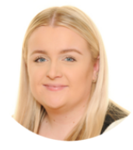
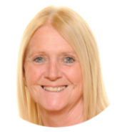

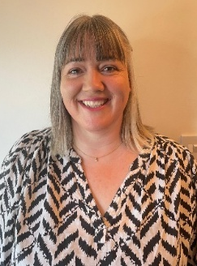
Y1 Teaching Staff
The children are in two registration classes:
Mrs Dicken (Mon- Thurs) is also in the Year 1 and Year 2
teaching team for phonics, teaching cover and interventions.
M Miss Evans 1E) | Mrs Pratt (Mon, Tues) Mrs Gorton (Wed, Thurs, Fri) r/Mrs Pratt (1GP)

Slide 4
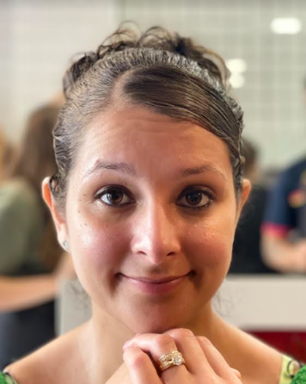
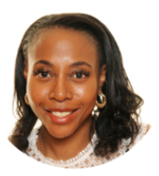
Y1 Support Staff
Mrs Thear, Mrs Mclaren support learning in our team also.
We build up to children learning with different members of staff during the day for different lessons.

Slide 5

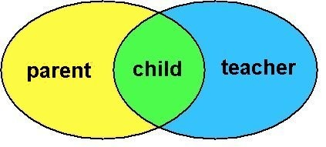
A message from our
Parent Partnership Team
We welcome you on this next stage in your child’s learning journey. We look forward to working with you to enhance the relationships between home and school which can lead to happy and successful children.
Throughout the year ahead, we hope to continue to welcome you into school to share learning experiences and progress meetings as we work closely together for your child. We may ask you for your feedback to help us to see how effective our provision is in your eyes.
We would like to know constructively how, we could improve our provision for you or any aspect of school life. If you feel that we could run workshops to help learning at home or point you in the direction of developing your own learning skills, we aim to assist you in any way we can.
Please look out for updates on the school’s website or the newsletter.
At any time, please speak to your child’s class teacher, or Mrs Dicken (Y1).
Any written suggestions can also be dropped at the post box in the school’s reception.

Slide 6


Safeguarding
At Hall Green Primary School; the health, safety and
well-being of our children is of paramount concern to us.
Our aim is for children to enjoy their time as pupils in our school. We want to work in partnership with you to help your child achieve their full potential and make a positive contribution to the world they will be part of in the future.
Please let us know about any changes in the children’s lives
that may affect them, so that we can help to support them too.

Slide 7



Our School Aims & Values
The aims of the school are the same for all pupils within a caring, positive, disciplined and safe environment and in partnership with parents and governors.
Resilience
Perseverance
Courage
Honesty
Trustworthiness
Integrity
Respect
Tolerance
Kindness
Empathy
Co-operation
Collaboration
Ownership
Responsibility
Independence
Accountability

Slide 8



Behaviour & Discipline Policy
At Hall Green Primary School, discipline is recognised to be a collective responsibility between parents, staff, governing body, children and other agencies involved with school.
It is vital that staff, parents and pupils understand it clearly and that it is consistently applied.

Slide 9

School Times
Children are to arrive through the Y1 door from 8:45a.m. This door closes at 9:00a.m. If you arrive after this time, please go to office to sign in. Late marks are given after 9:05a.m.
Our day
Morning session: 8:45 a.m. – 12:00 p.m.
Afternoon session: 1.00 p.m. – 3.25 p.m.
If your child is late or absent they will miss sessions, it could disrupt their settling in and mixing with friends. Having a regular attendance will help to give your child the best start in life. Your child’s attendance should never fall below 90%.

Slide 10


Our first day…
Please let your child know you are leaving, who is picking them up, and wave them off with a happy face, then move away for a deserved coffee or tea.
They should have a book bag, labelled water bottle and packed lunch if that is your child’s preferred option. NO BIG BAGS PLEASE.
Your child will NOT need a PE bag this year.
Year 1 teachers will be greeting the children on the door for the first week.
At home time, please be on time or let the office know
of any issues with childcare so we can reassure your child.

Slide 11
School Uniform
We have a school uniform, which we think is very smart and practical, not to mention economical. We may have some pre-loved uniform if you would find this useful.
Please label all uniform items clearly with your child’s name in marker pen. That way if clothes are lost they can be found easily in lost property. We ask children to put their jumpers into their tray.
We cannot be held responsible for items which go missing, but we can find clothing more easily if it is named clearly.

Slide 12


Further Information
Morning snack time (10:20)
Year 1 children do not have toast. Please make sure they have had breakfast before school. They will be offered a free piece of fruit at snack time.
Milk is available for you to buy online. If you would like your child to drink milk you will need to complete an order form and send it off or apply online.
We recommend that your child brings a labelled water bottle everyday.
Y1 Biscuit Fund
This is £1 a week collected weekly which pays for extra afternoon snack item. Any surplus money is used to fund activities to enrich
the curriculum like cooking or special craft items.

Slide 13

Keeping in touch
Look out for the school calendar and newsletters so that you are aware of key school dates.
The school also currently operates a text message service; so please make sure your mobile number is up to date. We continue our move on our new Arbor system, which you have hopefully signed up to.
If your child is ill or has an appointment please ensure you inform our school office. It is important even at this early stage your child regularly attends school.
If your child is late or absent they will miss sessions, it could disrupt their settling in and mixing with friends. Having a regular attendance will help to give your child the best start in life. Your child’s attendance should never fall below 95%.

Slide 14



Curriculum Areas
Year 1 is the start of Key Stage 1 and therefore the National Curriculum will be introduced.
This comprises of the following areas:
English Maths Science Computing
RE PE
Geography History
Art & Design Music
Design Technology PSHE

Slide 15
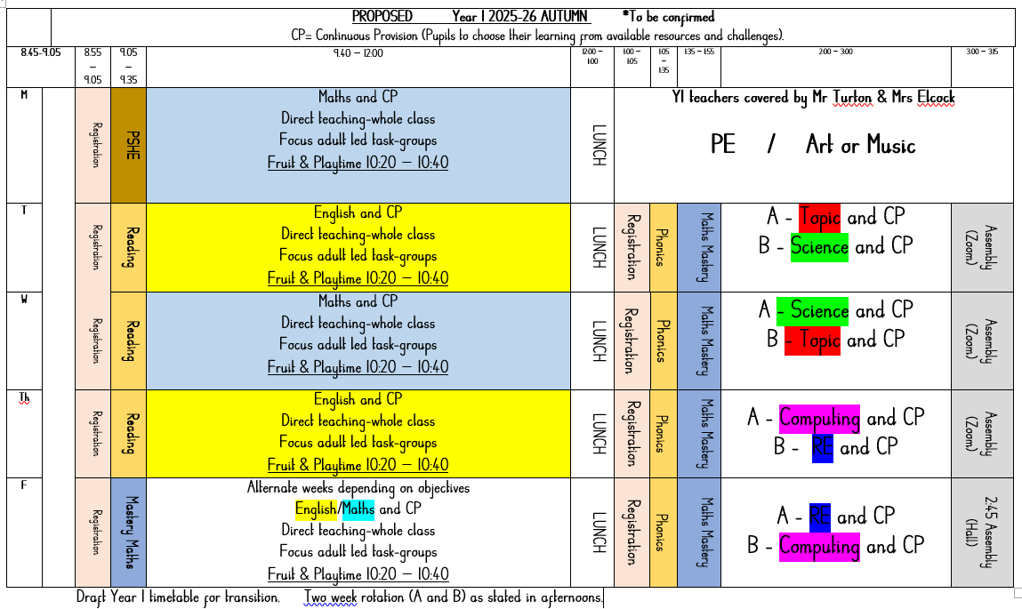
Draft Year 1 timetable

Slide 16
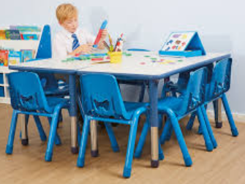
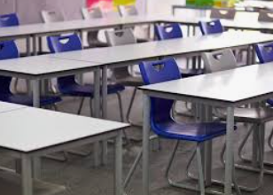
Learning Environment
We use our knowledge of the children to judge how to transition the children into sitting on a chair to learn.
We move the furniture to make 6 group tables at the start for Continuous Provision (choice learning) to take place. We aim to put the tables in lines by October half term give or take a few weeks, again depending on the children.
Then we move to a more formal sitting
down at tables to all learn together.

Slide 17



Days to remember
Mondays
Please can you bring in £1 for biscuit fund.
Please return our Big Cat Phonics Reading scheme books.
Please come dressed ready for P.E. Remember that children will wear these clothes out to play and lunch.
‘Books to Share’ can be returned and swapped any day by your child.
‘Books to Read’ will be set weekly online and a copy of the book sent home at the end of the week for a return on a Monday. We ask for this as the next group will be waiting to read your child’s book with a teacher.

Slide 18
Our possible first half term of learning…TBC
Subject | Topic / Skills
English | Basic skills – letter formation, writing CVC words, writing captions.
Maths | Place Value -numbers to 10 Addition & Subtraction to 10
Phonics | Little Wandle daily lessons in ability groups
Science | Materials and Seasons
History | Now and Then
RE | What do Christians believe God is like?
Computing | Online safety
PE | Movement skills & Ball skills
Music | Hip Hop
PSHE | Physical health and mental well-being / Growing and changing

Slide 19

National Phonics Screening
On the week of Monday 8th June 2026, all Y1 children across the country complete a National Phonics Screening assessment.
We will have a separate Phonics
Screening meeting in Spring to give
you further information.

Slide 20


Helping at home over the summer…
Encouraging independence skills e.g. zips on coats, taking jumpers off, shoe laces etc.
Counting forwards and backwards to 20, 50 then 100.
Reading and sharing stories everyday. Stone Cross Library has free holiday events on. Children are allowed 30 books on their ticket.

Slide 21

In Autumn 1, we will invite you back in to share our Y1 Curriculum with you and show you how our transition classroom looks.
We greatly look forward to working together with you.
If you have any further questions after today, please come and speak to us or email: year1@hallgreenprimary.co.uk

