Slide 1


A safety how-to guide for parents and carers

Slide 2
Why this matters
Nearly half of our Year 5 and 6 children have said they are regular users of Snapchat.
41% of regular users said they see content from people they don’t know.
56% of our children said they have received a message off people they don’t know.
Approximately half of our children said that have felt sad or angry while using Snapchat.
52% of users know that there are risks to using Snapchat but still use it anyway.

Slide 3
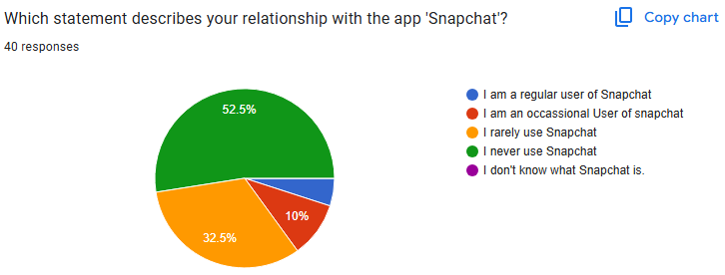
Parent survey

Slide 4
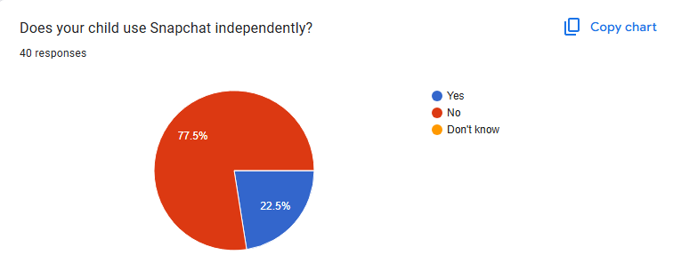
Parent survey

Slide 5
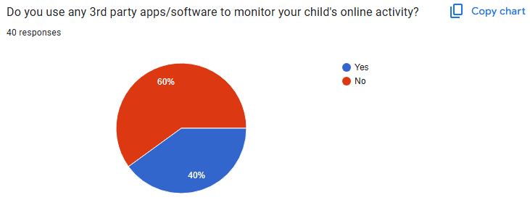
Parent survey

Slide 6
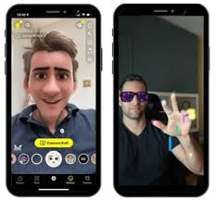

What is Snapchat?
Snapchat is a communication service popular among teens and adults.
Users can take photos, record videos, add text or drawings (called Snaps) and send them to Friends.
Snaps disappear after the recipient views it, or within 24 hours (for a Story or Chat).
Once all recipients have viewed a Snap, it will be automatically deleted from Snapchat’s servers unless the users save the content.

Slide 7

To register, users must download the social media app to their device.
Then they must enter their date of birth and create and username and password. Users are then asked to enter their mobile phone number. This is an optional step to help if you get locked out of your account. However, you can use email instead if you prefer

Slide 8

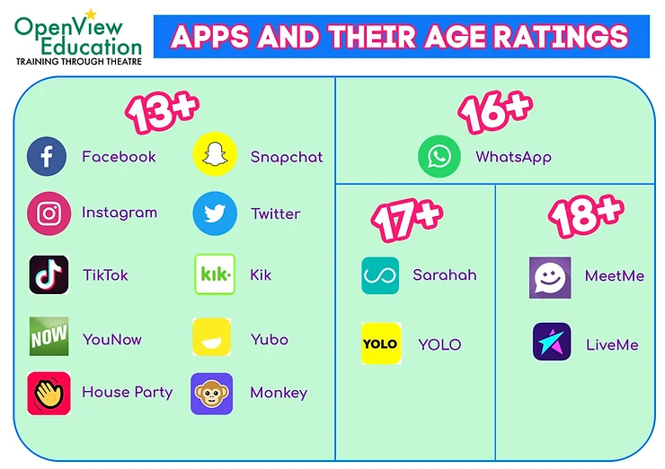
What is Snapchat's minimum age?
Like many other social networks and messaging apps, the minimum age to use Snapchat is 13 years old, with parents’ permission.

Slide 9

How it works
It was initially a private photo-sharing app. However, Snapchat features now include short videos, video chat, messaging, photo storage, generative AI and more.
Each Snap shared with your followers is temporary and is available for 24 hours unless you delete it or set a different limit. You can also add different filters, lenses, emojis and text to your Snap. Additionally, you can create a group chat to talk with friends or message individual friends.
Notes:
Mention read receipts can lead to issues with control, we all know that family member that might read a message and not reply straight away.

Slide 10

Stories and Spotlight
The Stories feature – works as a newsfeed featuring content from news publishers and well-known people. Some use this feature to meet new people.
The Spotlight feature – working like TikTok, Spotlight is a dedicated tab in Snapchat for promoting short viral videos. The Spotlight feature will use an algorithm to recommend the ‘most engaging’ posts to
watch based on what a user is interested in.
Notes:
Mention read receipts can lead to issues with control, we all know that family member that might read a message and not reply straight away.

Slide 11

Snapchat offers users the option to engage with an artificial intelligence tool called My AI. It appears in users’ contact lists automatically.
Unlike other contacts, My AI cannot be deleted unless you have Snapchat+, Snapchat’s premium subscription option.
My AI works like any other chatbot,
allowing users to have conversations with AI.

Slide 12

Like ChatGPT, it can also provide more detailed answers like the solution to a Maths problem.
With any AI tool, it’s important that children understand appropriate and inappropriate ways to use it to support skill-building.

Slide 13

What data does My AI collect?
Like ChatGPT, My AI collects data from conversations users have with it. If location is enabled, My AI can use that to help answer questions users ask it. If you share content like written messages or Snaps, My AI keeps that data as well. This helps it ‘learn’ facts about users to better answer questions.

Slide 14

According to the Snapchat’s Help Centre, users should avoid sharing confidential or sensitive information with My AI.
Additionally, it is against the rules to ask My AI to generate harmful content such as that which promotes violence, self-harm, human trafficking or any content that goes against the Community Guidelines.

Slide 15
How do I delete data from My AI?
If your teen regularly uses My AI, it’s a good idea to get in the habit of routinely deleting their data. You can do this by going to their account Privacy Controls in their Settings, selecting ‘Clear Data’ and then choosing ‘Clear My AI Data.’
Additionally, make sure you talk to your teen about what is and is not okay to share with artificial intelligence like My AI.

Slide 16
Risks and benefits
If your child uses Snapchat, it’s important to understand both the potential risks and benefits. However, these might not apply to all young people, so it’s important to consider your individual child’s maturity, online experience and critical thinking skills.

Slide 17
Snapchat risks
Similar to other social media platforms, common risks on Snapchat include:
contact from potentially harmful strangers
seeing inappropriate content
endless scrolling (or ‘doom scrolling’)
bullying, harassment or hate from both friends and strangers
disappearing messages, which can make it hard to collect evidence in cases of bullying or similar behaviours.
Snapchat has its own Community Guidelines to help users stay safe. Inappropriate content, bullying and more are not allowed on the platform. However, if your child does see something upsetting, they should report it in-app.

Slide 18
Snapchat benefits
Social media is a large part of teens’ lives, and apps like Snapchat can help support important aspects. Some benefits include:
a variety of ways to connect with friends
creative tools to have fun with friends such as different filters,
AI
messaging features to help some teens develop social skills or find connection with others.
This is especially beneficial for children who have additional learning needs such as autism and may struggle to communicate offline a creative outlet to show off their personality and interests

Slide 19
What is Family Centre on Snapchat?
Snapchat’s Family Centre is an in-app suite of parental controls to help parents and carers engage with their teens’ digital life. Monitoring who your teen talks to or setting content controls help prompt important conversations about online safety.
Family Centre reflects the dynamics of offline relationships between parents and teens, where parents have insight into who their teens are spending time with, while still respecting teens’ privacy. On Family Centre, parents can also easily and confidentially report any concerns directly to Snapchat’s Trust and Safety teams, which work around the clock and around the globe to help keep users safe.
To set up Family Centre, parents must have their own device with Snapchat installed as well as their own Snapchat account

Slide 20
Alternatives
Zigazoo
Zigazoo is a social media app geared towards kids. It shares similarities with TikTok and lets users create short-form video content to share with others. It focuses on positive interactions with others and requires parent permission to access some features. There are also child-friendly challenges to inspire creative content.
Safety features
Parents must sign up their child using their own email to verify children’s accounts.
You can allow your child to join the global community, but you don’t have to. Instead, you can decide to keep their interactions local to their school and wider community.
There are options to share privately or publicly.

Slide 21
Kinzoo Messenger
Kinzoo Messenger is a family- and child-friendly messaging app that uses wifi rather than a mobile number. It lets users make video calls and share pictures, text and videos with chosen family and friends.
Safety features
It does not use persuasive design to keep children using the app, which can help children take breaks.
The community is limited to your child’s family and friends rather than a global community.

Slide 22
Thank you!
Any questions?

