Slide 1


Hall Green Primary School
Year 5
YOUR CHANCE TO SHINE

Slide 2
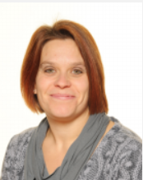
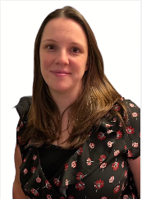
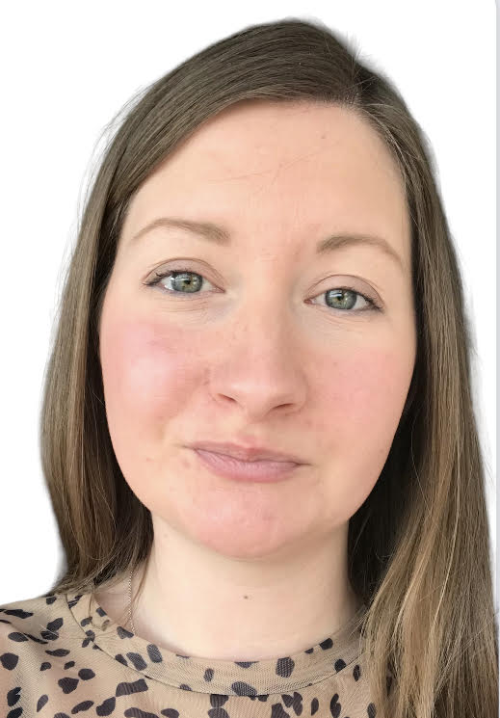
Our Head Teacher, Deputy Head Teacher, Safeguarding & Attendance Officer
Mrs Gilbert Mrs MacDiarmid Mrs Taylor

Slide 3
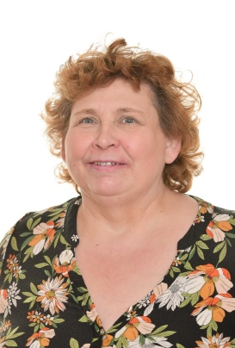
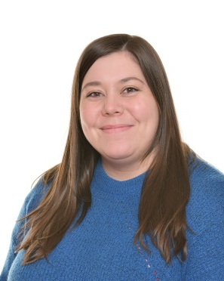
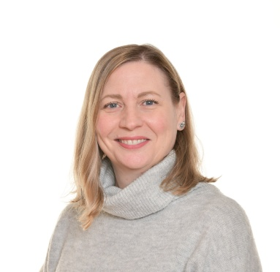
Staff
Miss Webley Mrs Goodreds Mrs Scott
Mrs Payton
Miss Jones
Miss Powell

Slide 4

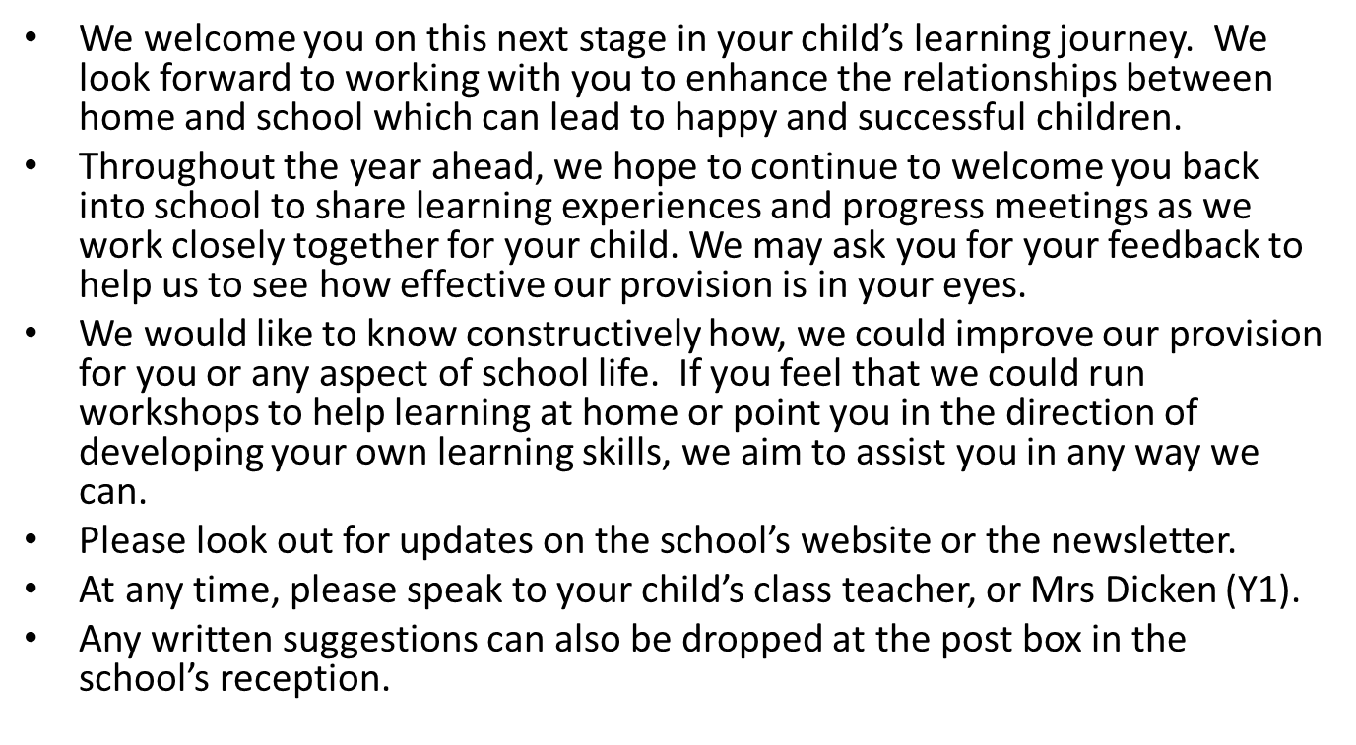
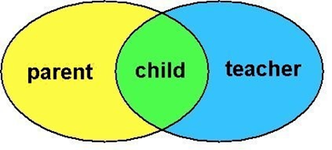

Slide 5


Safeguarding

Slide 6
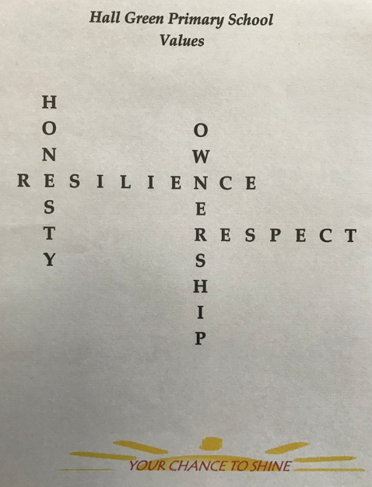


Our School Aims & Values
The aims of the school are the same for all pupils. Within a caring, positive, disciplined and safe environment and in partnership with parents and governors.
Resilience
Perseverance
Courage
Honesty
Trustworthiness
Integrity
Respect
Tolerance
Kindness
Empathy
Co-operation
Collaboration
Ownership
Responsibility
Independence
Accountability

Slide 7
Structure
AM
Registration
Shared reading/assembly
English
Playtime
Maths
Lunchtime
PM
Science
History
Geography
Computing
RE
PE
ART
Music
MFL
Spelling
Lightning maths
PE and art or music is on a Tuesday morning with Mr Turton and Miss Elcock

Slide 8
National Curriculum
Reading
By the beginning of year 5, pupils should be able to read aloud a range of poetry and books written at an age-appropriate interest level with accuracy and at a reasonable speaking pace. They should be able to read most words effortlessly and to work out how to pronounce unfamiliar written words with increasing automaticity. If the pronunciation sounds unfamiliar, they should ask for help in determining both the meaning of the word and how to pronounce it correctly.

Slide 9
National Curriculum
Writing
Pupils should be able to write down their ideas quickly. Their grammar and punctuation should be broadly accurate. Pupils’ spelling of most words taught so far should be accurate and they should be able to spell words that they have not yet been taught by using what they have learnt about how spelling works in English.

Slide 10
National Curriculum
Maths
The principal focus of mathematics teaching in upper key stage 2 is to ensure that pupils extend their understanding of the number system and place value to include larger numbers. This should develop the connections that pupils make between multiplication and division with fractions, decimals and percentages.

Slide 11
Assessments
Half termly tests in reading
Half termly maths assessment
Termly assessment of CEW
Writing assessments (2 or 3 a half term)
Half termly SPaG assessment
Termly reading and comprehension ages

Slide 12
Topics
Autumn
Interstellar explorers -Space
The Empire strikes back - Romans
Master chef – Materials, reversible and irreversible changes.
Pulleys and levers- Catapults
City Slicker- land use and settlements
Spring
Outdoor learning
May the force be with you-Forces (such as gravity)
Structures - landmarks
Traders and raiders - Anglo Saxons.
Summer
Animals including Humans- The Human life cycle
Living things and their habitats
A tale of two continents - America vs UK.
Healthy meals

Slide 13
Independence
Knowing about their own health, hygiene or dietary requirements
Remembering their belongings like bottles or clothes
Changing their reading book or bringing in their signed reading records

Slide 14
Support at home
Communicate - home time
                - email
                - newsletters
                - termly calendar
                - website
                - text2parents
Parents evenings/phone-calls
All About Me meetings/phone-calls
Please make sure your mobile number is up to date with the office

Slide 15

Thank you for joining us today.
If you have any further questions after today, please email us on:
year5@hallgreenprimary.co.uk

