Slide 1
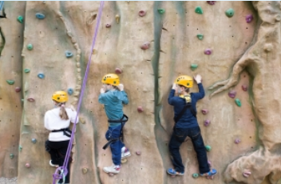
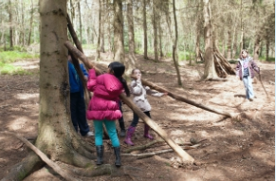
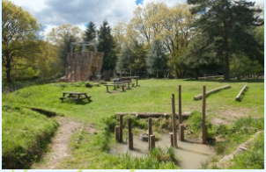
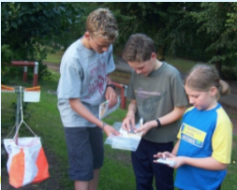
Frank Chapman
Wednesday 24th – Friday 26th June 2026
Hands on experience of touch, feel and smell give young people the opportunity to take on new challenges that can help them back in the classroom and home. Often it is the first time away from home and an experience they will remember all their life.
Outdoor learning develops team work, independence skills, new experiences, social and personal skills

Slide 2
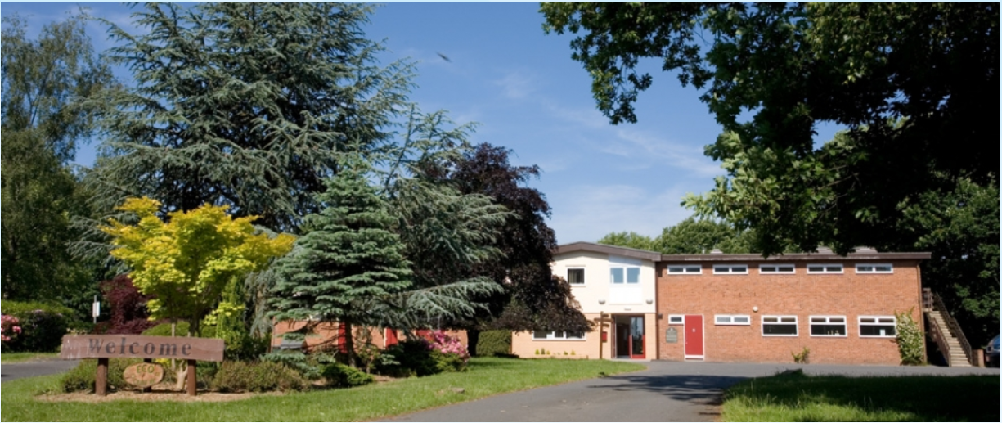
Frank Chapman
Wednesday 24th – Friday 26th June 2026

Slide 3
Frank Chapman
Wednesday 24th – Friday 26th June 2026
Frank Chapman (Bewdley, Worcestershire)
Purpose built residential building ran by Sandwell Council which is why we use this centre along with Edgmond Hall
http://frankchapmancentre.co.uk

Slide 4
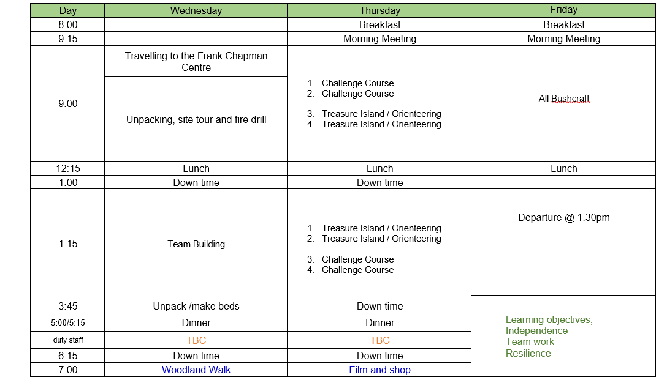
Example Frank Chapman Timetable

Slide 5
Staff
The staff attending with the children are:
Mrs Read
Miss Stokes
More TBC

Slide 6
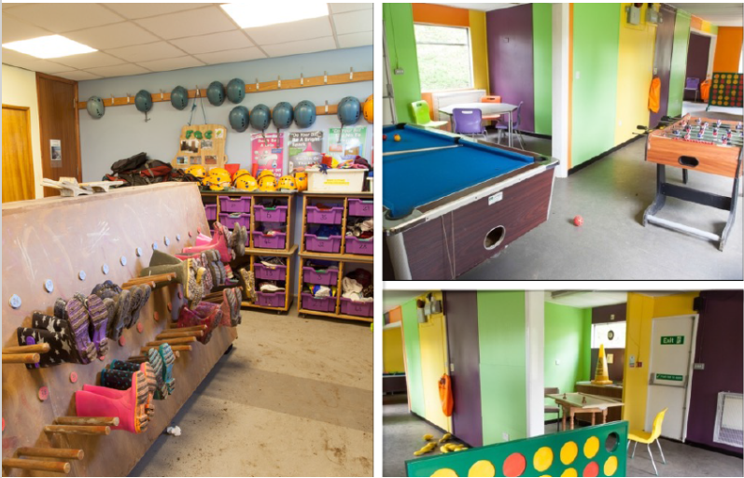

Slide 7
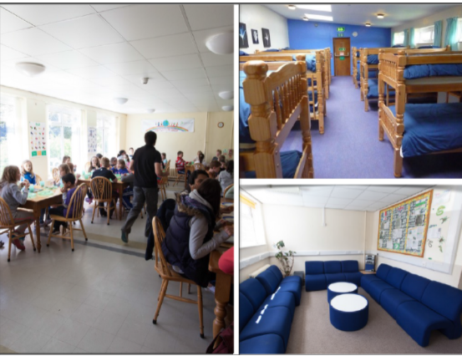
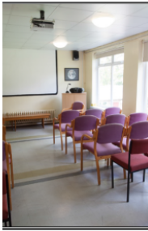

Slide 8
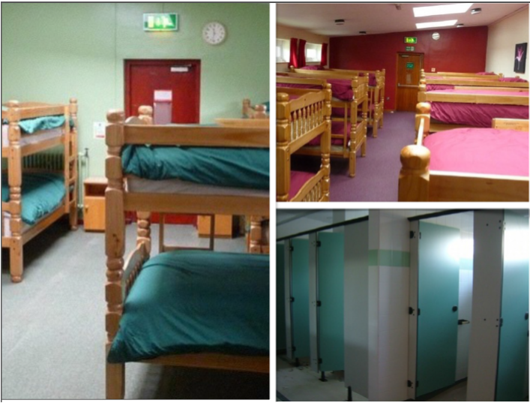

Slide 9
Frank Chapman
Wednesday 24th – Friday 26th June 2026
What can my child bring/not bring to the centre?
Can
Lots of clothes – packed day by day
Teddies
Suitcase
Pillows
Can’t
Electronic device
Additional food
Additional money

Slide 10
Frank Chapman
Wednesday 24th – Friday 26th June 2026
Next steps
Deposit via Arbor and consent letter by Friday 27th March.
Arbor is open for payments on Monday 8am
Complete forms which will be sent out upon receipt of the deposit.
Near the time: Second meeting

Slide 11
Frank Chapman
Wednesday 24th – Friday 26th June 2026
On the day
Please arrive at school at the normal time 8.45am-9.05am on Wednesday 24th June and make your way to the REAR hall door.
All children will need a packed lunch on Wednesday. If you are eligible for Free School Meals and require school to provide this meal, please let us know by Friday. All other meals will be provided by Frank Chapman.
Children and parents should come into school through the hall doors at the BACK of the school. Parents/carers should sign their children in and hand over any medication, letters, money and information we need upon entry. Parents will be allowed to wait with their children in the hall until the bell goes for the school day (9.05am).
If children have siblings in other year groups they will need to be taken to their normal entrances at the normal time. Parents/carers can then wait outside to see their children get on to the coach if they wish.

Slide 12
Frank Chapman
Wednesday 24th – Friday 26th June 2026
On the day
Please bring any medication in a labelled container/bag with your child’s name on and hand the adults on the door as you enter (there will be a clear designated place for this).
We can only accept medication with a doctor’s label on with the child’s name unless previously discussed with us.
If you need to bring medication – please make sure we are aware of it before hand and that it written on your child’s medical form that you will have hopefully already handed in.

Slide 13
Frank Chapman
Wednesday 24th – Friday 26th June 2026
You will receive a text when we arrive on Wednesday morning to let you know we have got there safely and a text on Friday when we are back at school and ready for you to collect your children.
We are hoping to arrive back at school before 3.25pm but we will keep you informed.

Slide 14
Common questions
How much does it cost?
Who will be going?
Where will they stay?
What will they eat?
How do we contact our children?
Worries
My child takes medication
They wont sleep
My child wets the bed
My child wears pull ups
They are going to miss me
My child has dietary requirements

Slide 15
Frank Chapman
Wednesday 24th – Friday 26th June 2026
All courses include
Personal and social development
First hand experience learning
Key skills and thinking skills development
Environmental awareness
Activity skills development
Healthy lifestyles

