Slide 1



Year One
Phonics Screening Check
A Guide for Parents

Slide 2


What is Phonics?
Children begin to learn phonics (sounds) in early years, both nursery and reception. Once children begin learning sounds, these sounds are used orally to identify and make words. They will then begin to learn the letters which make each of the sounds and these are used to read and spell words.
next page

Slide 3

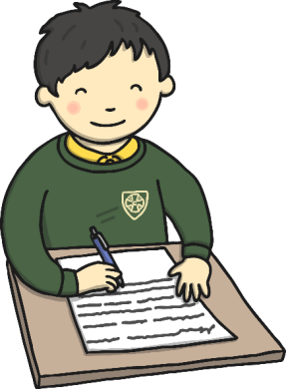
What is the Phonics Screening Check?
Children in Year 1 throughout the country will all be taking part in a Phonics Screening Check during the same week in June. This year it will take place from Monday 8th June. Children in Year 2 will also take the check if they did not achieve the required result when in Year 1 or they have not taken the test before.
Head teachers decide whether it is appropriate for each of their pupils to take the phonics screening check. The Phonics Screening Check is designed to confirm whether individual children have learnt phonic decoding and blending skills to an appropriate standard.
next page

Slide 4
What Happens During the Test?
The test contains 40 words.
Each child will sit one-to-one and read each word aloud to a Year 1 teacher in a quiet room.
The test will take approximately 10 minutes per child, although all children are different and will complete the check at their own pace.
The list of words the children read is a combination of 20 real words and 20 pseudo words (nonsense/alien words).
next page

Slide 5

Pseudo Words (Nonsense/Alien Words)
The pseudo words will be shown to your child with a picture of an alien. This provides the children with a context for the pseudo word which is independent from any existing vocabulary they may have. Pseudo words are included because they will be new to all pupils; they do not favour children with a good vocabulary knowledge or visual memory of words.
next page

Slide 6
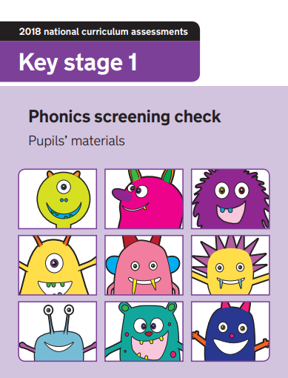
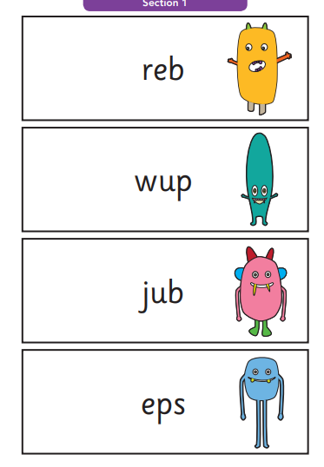
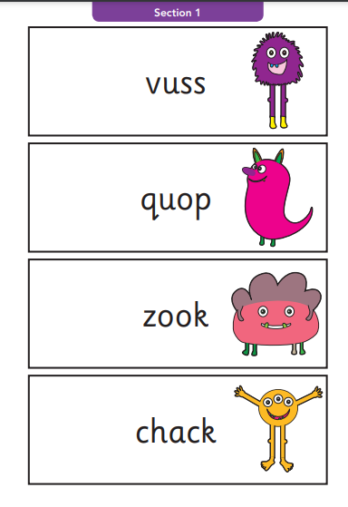
What does the test look like?
next page

Slide 7
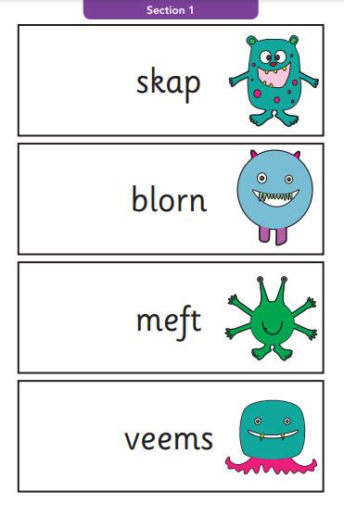
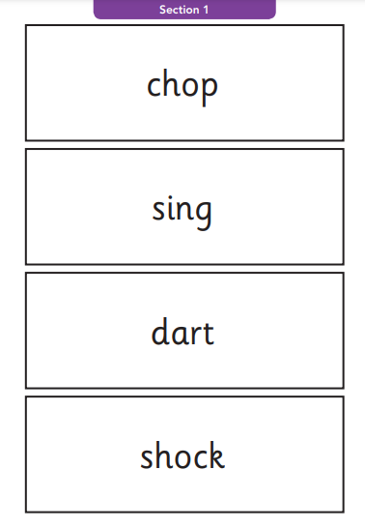
What does the test look like?
next page

Slide 8
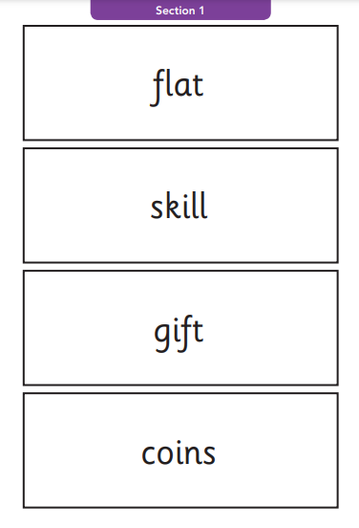
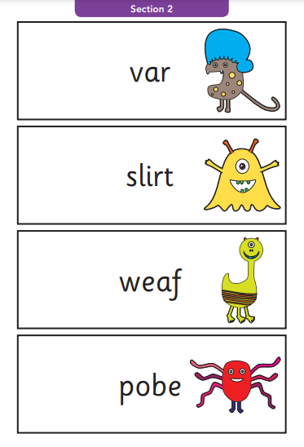
What does the test look like?
next page

Slide 9
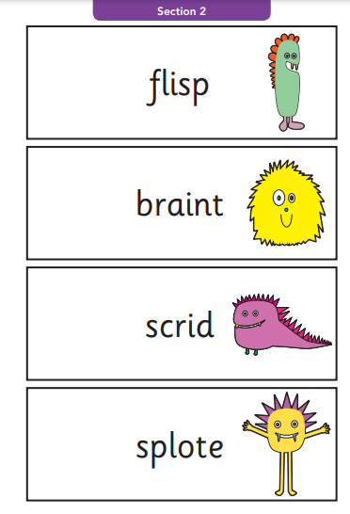
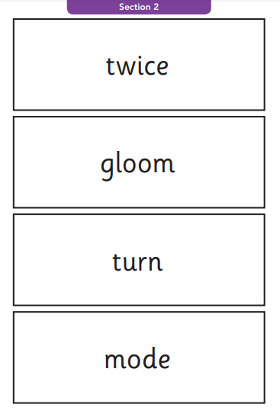
What does the test look like?
next page

Slide 10
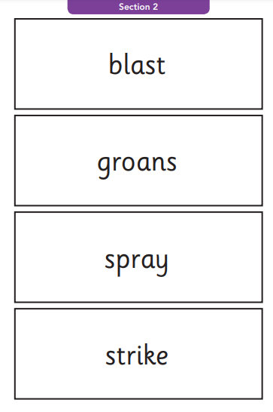
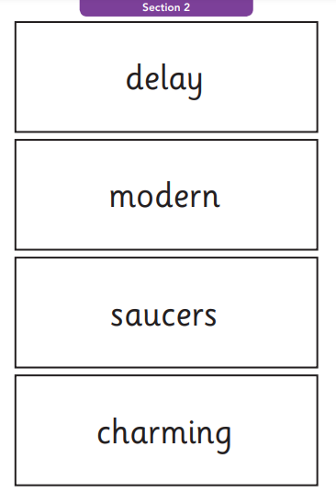
What does the test look like?
next page

Slide 11

Reporting to Parents
By the end of the summer term all schools must report each child's results to their parents. They will also confirm if the child has met the standard threshold. Children who do not achieve the expected level will retake the test when they are in Year 2.
next page

Slide 12
How Can I Help My Child at Home?
Read as much as possible to and with your child. Please use our Big Cats books as these decodable books reinforce learning in Phonics. You can catch up with previous books using their online account.
Encourage and praise – get them to have a ‘good guess’.
If your child is struggling to decode a word, help them by encouraging them to say each sound in the word from left to right. If it is a longer word, ask them to ‘chunk it’.
Blend the sounds by pointing to each one, e.g. /c/ in cat, /p/ in pat, /ng/ in sing, /ee/ in been. Next move your finger under the whole word as you say it.
During Summer 1 term, we will send home weekly sheets of extra reading practice some with QR codes.
Based on a mock test this term, some children will be invited to attend an ‘After School Phonics Club’ every Wednesday. If you receive a letter, please encourage your child to attend this FUN session.
next page

Slide 13
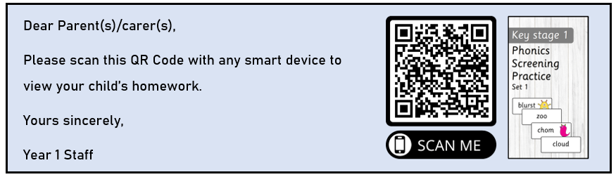
Weekly QR slips for home learning. A new one will come each week.

Slide 14




Any questions?
As always, you are welcome to chat to us about anything, at any time. If we feel that we need more time to talk to you, we can arrange a meeting.
next page

Slide 15
Thank you for joining us!
We appreciate your continued support.
Year 1 Team

